Slide 1

Command motion using moveit2 & CML
Anthony Redamonti

Slide 2
moveit2 Overview
Robotic manipulation platform for ROS2 (open-source robotics middleware suite)
Features the latest advances in Motion Planning, Manipulation, 3D Perception/Visualization, Kinematics, Control, and Navigation

Slide 3
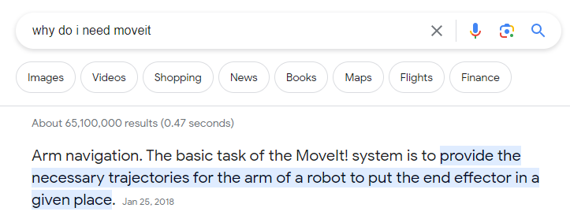
moveit2 Overview

Slide 4
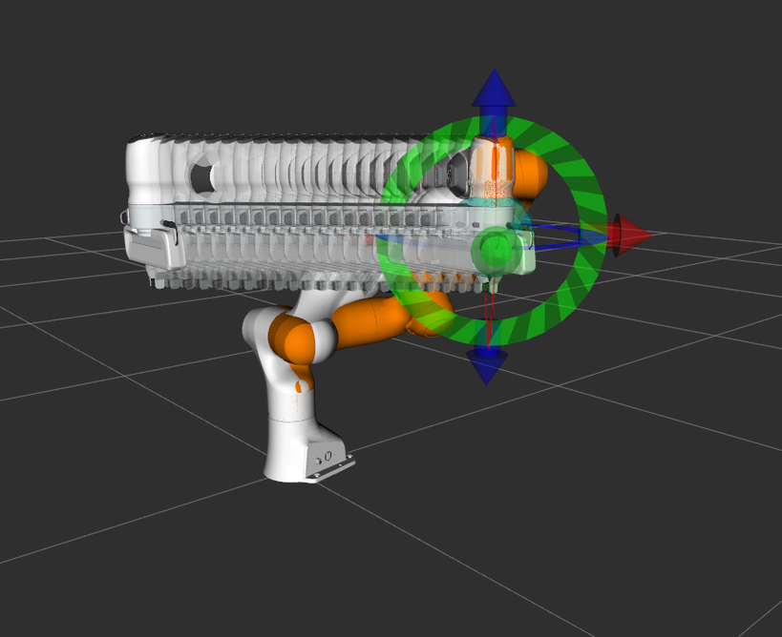
moveit2 plugin in rviz
We want the end effector to travel in a straight line
MoveIt2 uses ROS2 to calculate the position of each joint for each frame
Stream the positions to each joint in real-time using CML software

Slide 5
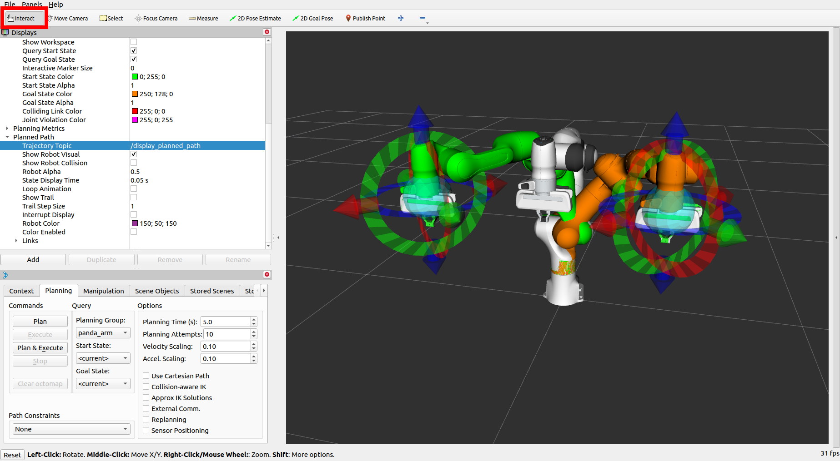
moveit2 plugin in rviz
Easy to use GUI to plan and execute trajectories!

Slide 6

rclcpp: ROS Client Library for C++
C++ API for interacting with ROS
Provides similar features as the RVIZ plugin
Your First C++ MoveIt Project

Slide 7
1. Target pose
Specify X,Y,Z coordinates and orientation of end-effector
// create a target pose for the robot geometry_msgs::msg::Pose target_pose; target_pose.orientation.w = 1.0; target_pose.position.x = 0.2; target_pose.position.y = 0.2; target_pose.position.z = 0.5; move_group_interface.setPoseTarget(target_pose);

Slide 8
2. Create a plan
Ask MoveIt to create a plan to the target pose
// create a plan to the target pose moveit::planning_interface::MoveGroupInterface::Plan my_plan; success = (move_group_interface.plan(my_plan) == moveit::planning_interface::MoveItErrorCode::SUCCESS);

Slide 9
3. Extract the trajectory
Get the list of commanded positions from the trajectory in the plan
// get the trajectory from the plan moveit_msgs::msg::RobotTrajectory msg = my_plan.trajectory_; std::vector<int>::size_type totalNumPvtPoints = msg.joint_trajectory.points.size(); printf("\nThe total number of PVT points = %ld", totalNumPvtPoints);

Slide 10
3. Extract the trajectory (cont.)
// extract all PVT data for (unsigned i=0; i<totalNumPvtPoints; i++) { printf("\nPVT point = %d", i); std::vector<double> pvtPoint; // get the size (how many axes are in PVT point) std::vector<int>::size_type size2 = msg.joint_trajectory.points[i].positions.size(); for (unsigned j=0; j<size2; j++) { float radFloat = msg.joint_trajectory.points[i].positions[j]; printf("\nAxis %d radians: %g", j, radFloat); float degrees = (180/PI_VALUE) * radFloat; // convert radians to degrees printf(" degrees: %g", degrees); degrees = degrees / 360.0; // 360 degrees in one rev double counts = degrees * (countsPerRevArr[j] * 1.0); // convert degrees to encoder counts printf(" counts: %f", counts); pvtPoint.push_back(counts); // record the starting position if(i == 0){ startingPos[j] = counts; } } // add the PVT point to the PVT constant acceleration object err = pvtConstAccelTrjObj.addPvtPoint(&pvtPoint, &timeBetweenPoints); showerr( err, "adding PVT point to pvtConstAccelTrjObj" ); }

Slide 11
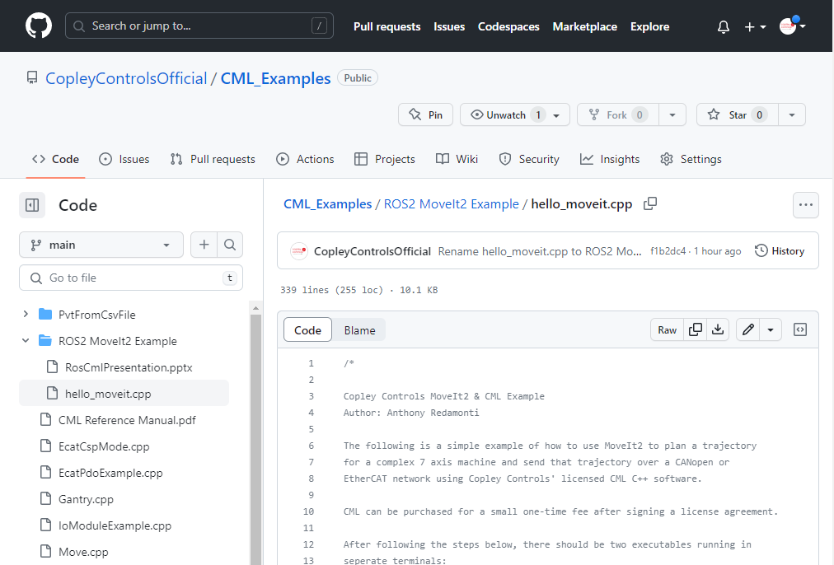
Copley controls Github page

Slide 12


Thank You
aredamonti@copleycontrols.com

